Slide 1
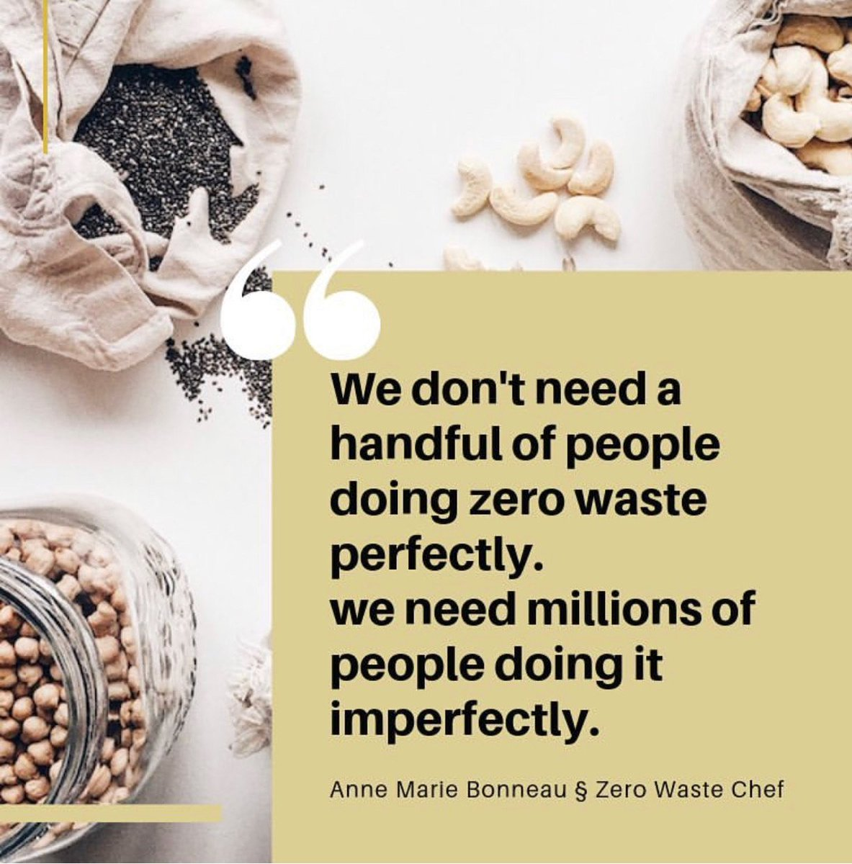
Zero-Waste Instagram Communities
Louise Spiteri
School of Information Management
Dalhousie University

Slide 2
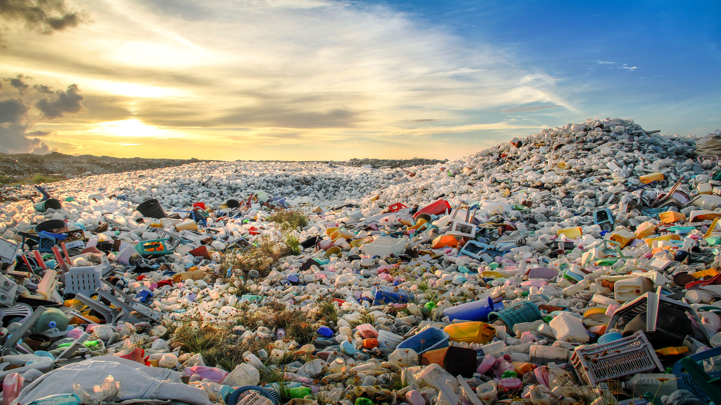
Drowning in waste
The World Bank estimated that by 2050, waste generation will drastically outpace population growth by more than double

Slide 3
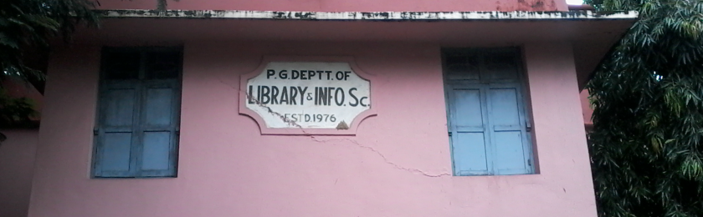
Zero waste and LIS
Increasing popularity of sustainable lifestyle movements = opportunity to examine how practitioners share meaning, identity, practice and goals to effect social change.

Slide 4
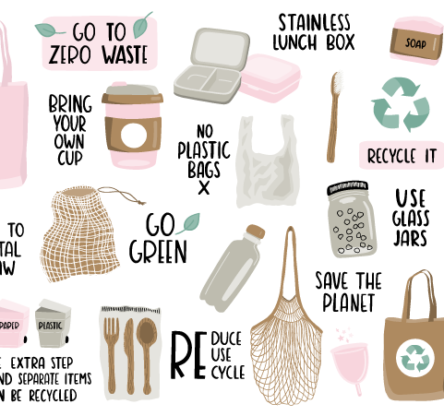
Goal
Examine the ZW activities that members of 5 ZW Instagram communities employ in their daily lives

Slide 5

Lifestyle Movements
Internally focused groupings driven by consumption and popular culture.

Slide 6

Lifestyle Movement Framework
Individual action
Social change
Identity work
Structurally diffuse

Slide 7
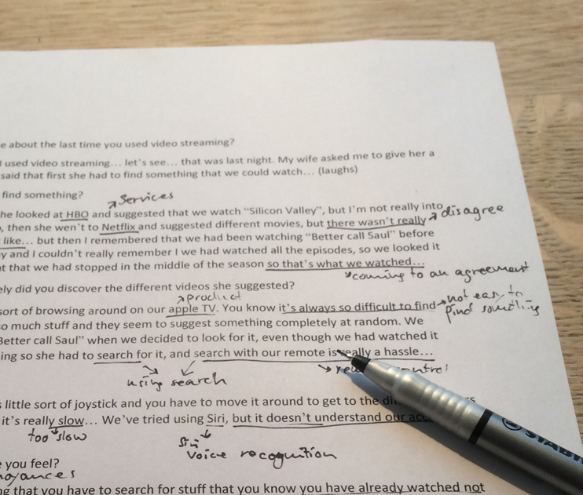
Method
Thematic analysis of 2000 member comments in 5 popular ZW Instagram posted from 2018-2019

Slide 8
ZW Instagram communities examined
Account | Followers | Owner
Going Zero Waste | 183,000 | Kathryn Kellogg
Wasteland Rebel | 100,000 | Shia Su
Zero Waste Chef | 172,000 | Anne-Marie Bonneau
Zero Waste Home | 267,000 | Béa Johnson
Zero Waste Nerd | 74,7000 | Megean Weldon

Slide 9
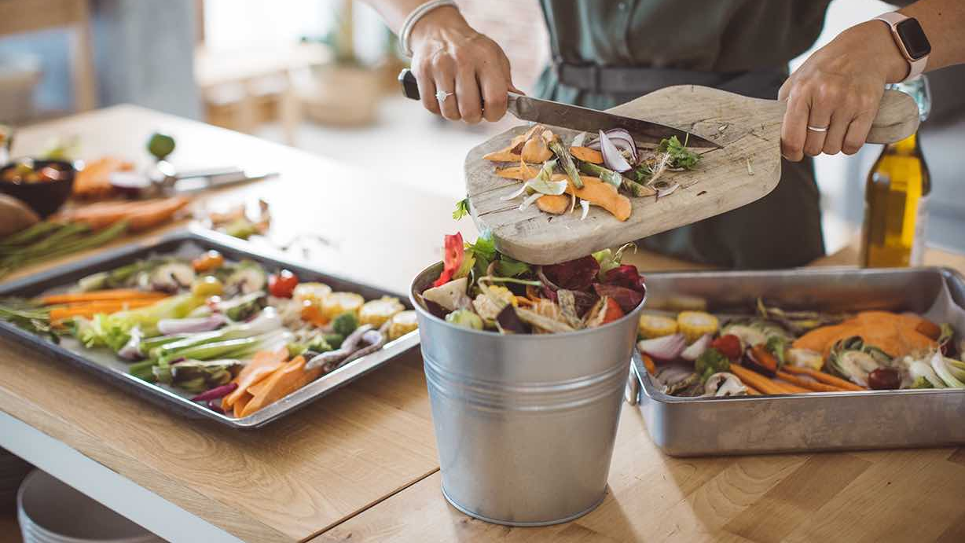
Findings
Seven themes, or groupings, of activities emerged.
36 sub-themes, or specific activities were identified.

Slide 10
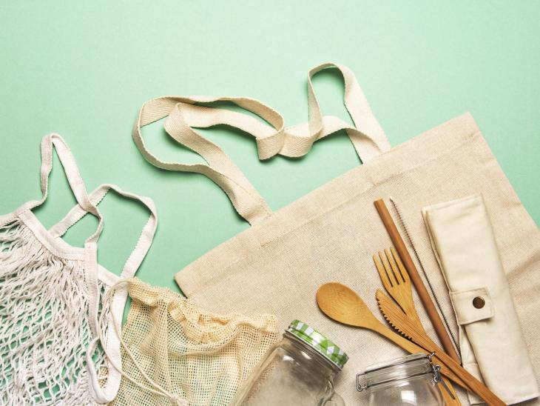
Themes 1-4
Theme | Sub-Themes
Avoiding environmental hazards | Eco-anxiety; Environmental effects; Packaging; Plastic; Trash; Travel
Buying behaviour | Fast fashion; Local goods; Marketing; Savings; Sustainable goods; Thrifting; Waiting; ZW consumerism
Dealing with social context | Greenwashing; Recycling fallacy
Dealing with ZW misconceptions | Bulk shopping; Cleaning; Farmers’ markets; Food preparation; Food waste; Health; Personal hygiene; Pets

Slide 11
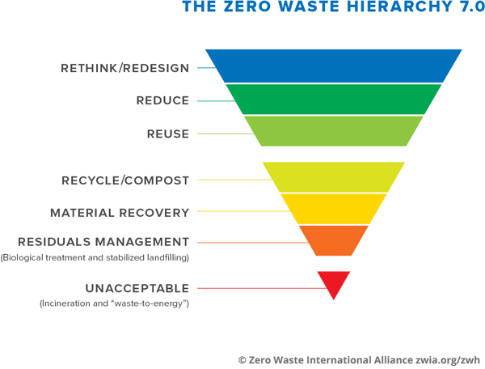
Themes 5-7
Theme | Sub-Themes
Household & personal care | Bulk shopping; Cleaning; Farmers’ markets; Food preparation; Food waste; Health; Personal hygiene; Pets
Waste hierarchy | Activities in which members engaged in relation to the zero-waste hierarchy shown in Figure 1, as it applies to their personal management of waste.
Zero waste swaps | Reusable cutlery; Reusable food containers; Reusable shopping bags

Slide 12
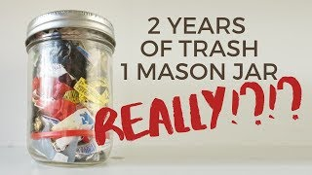
Discussion, 1
Comprehensive ZW activities
Societal and family factors
Isolation
Trash jar fallacy

Slide 13
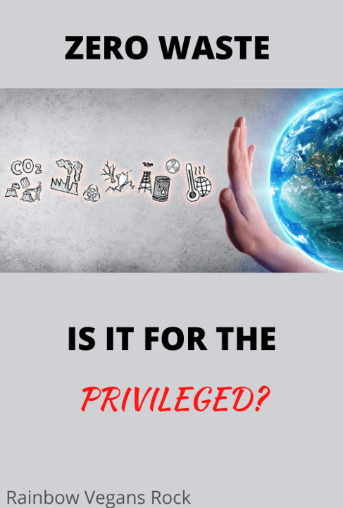
Discussion, 2
Lack of diversity
Privilege
Eco-anxiety

Slide 14

Future studies
Demographic and geographic variables (identity)
Support mechanisms (structural cohesion)
Perceptions of success (social aspect)

Slide 15
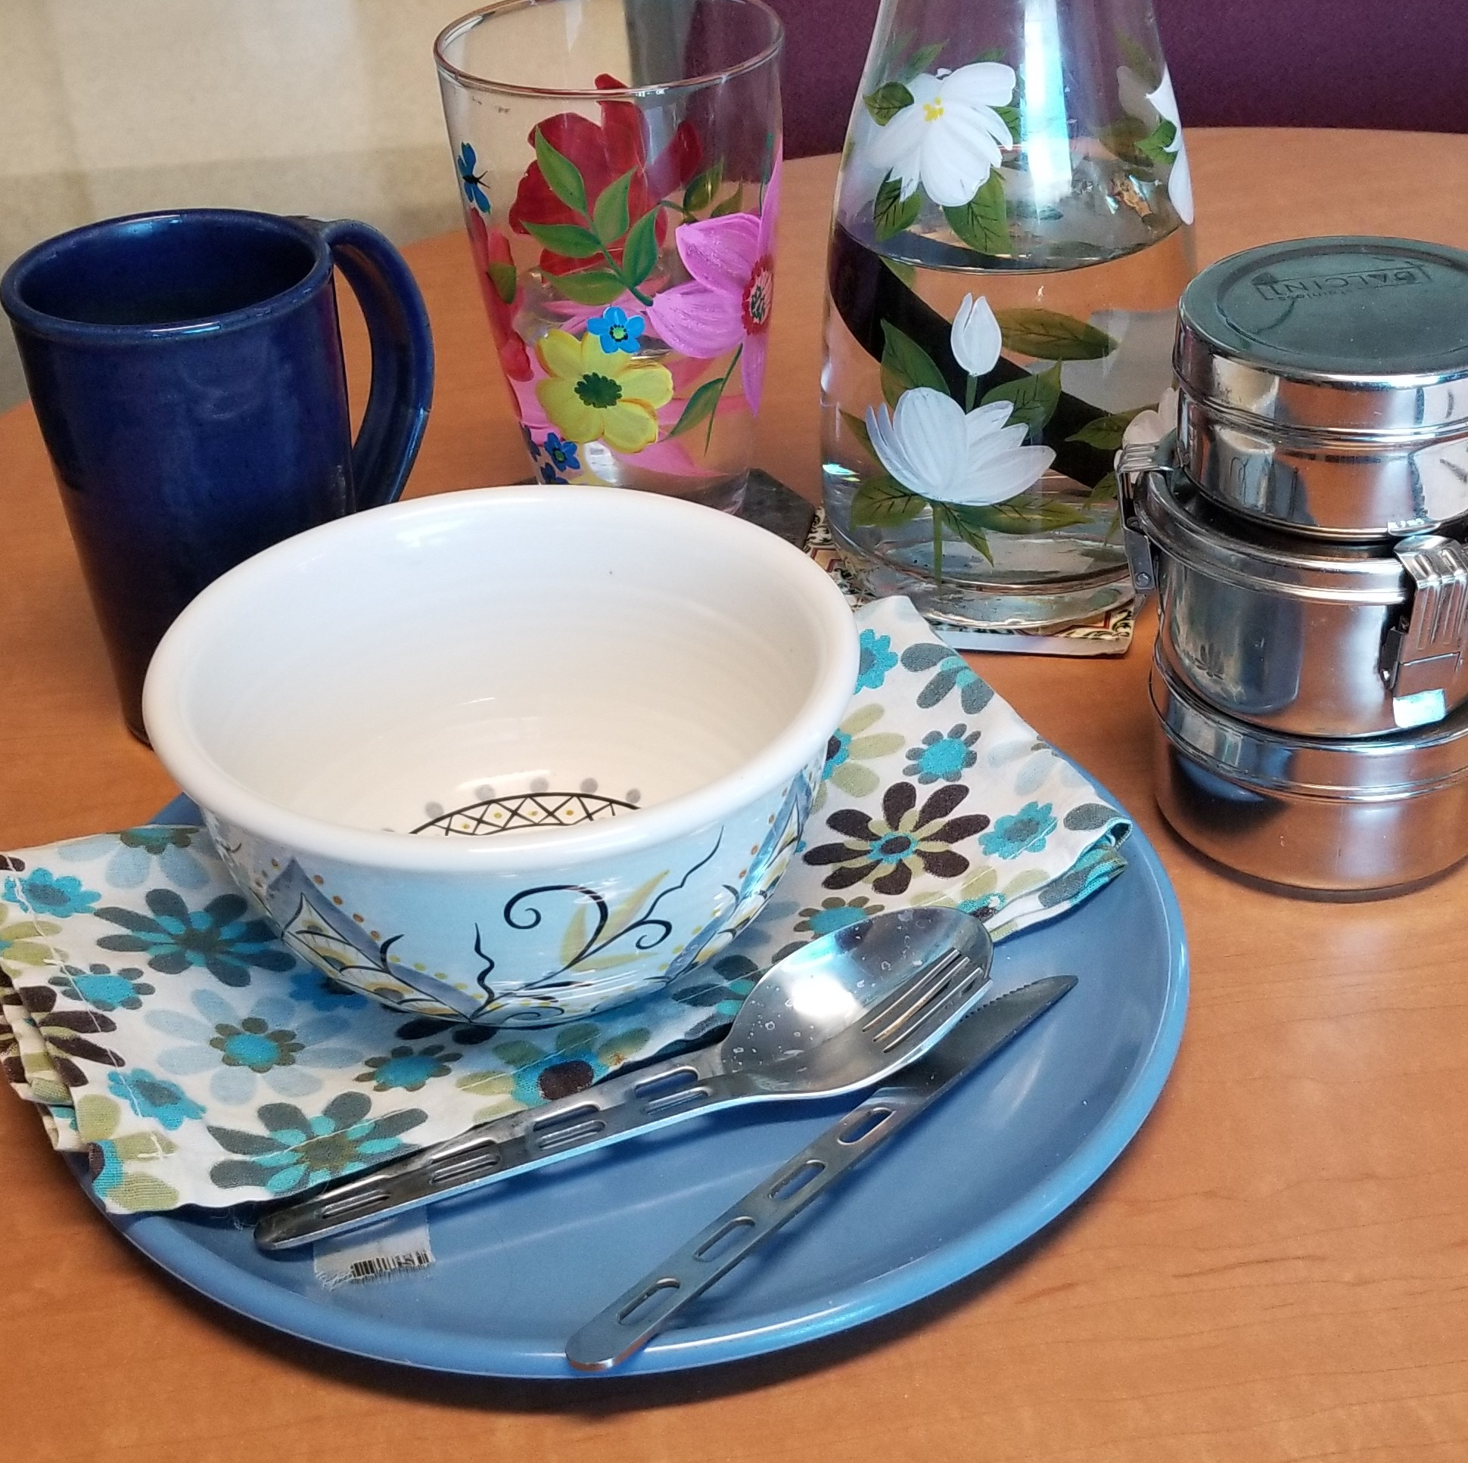
Follow me
Vegan Footprints: http://louisespiteri.ca
Twitter: @lfspiteri
Instagram: lfspiteri
My ZW office food kit

